Slide 1

Epidemiology III – Fall 2022
Aug 30, 2022

Slide 2
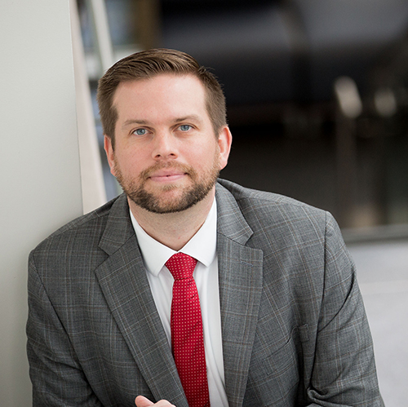
Brad Cannell, PhD, MPH
Director of UTH SPH Dallas Student Affairs
Associate Professor
Department of Department of Epidemiology, Human Genetics, and Environmental Sciences
Areas of interest:
Preservation of physical and cognitive function
Living/aging with disability
Understanding/preventing elder abuse
Data science and digital epidemiology
Courses
Epi III
Introduction to R programming

Slide 3
TA 1
Director of UTH SPH Dallas Student Affairs
Associate Professor
Department of Department of Epidemiology, Human Genetics, and Environmental Sciences
Areas of interest:
Preservation of physical and cognitive function
Living/aging with disability
Understanding/preventing elder abuse
Data science and digital epidemiology
Courses
Epi III
Introduction to R programming

Slide 4
TA 2
Director of UTH SPH Dallas Student Affairs
Associate Professor
Department of Department of Epidemiology, Human Genetics, and Environmental Sciences
Areas of interest:
Preservation of physical and cognitive function
Living/aging with disability
Understanding/preventing elder abuse
Data science and digital epidemiology
Courses
Epi III
Introduction to R programming

Slide 5
Icebreaker
Name
Where are you from?
What degree/concentration are you working on?
What are your career goals?
What are your goals for this class?

